Slide 1
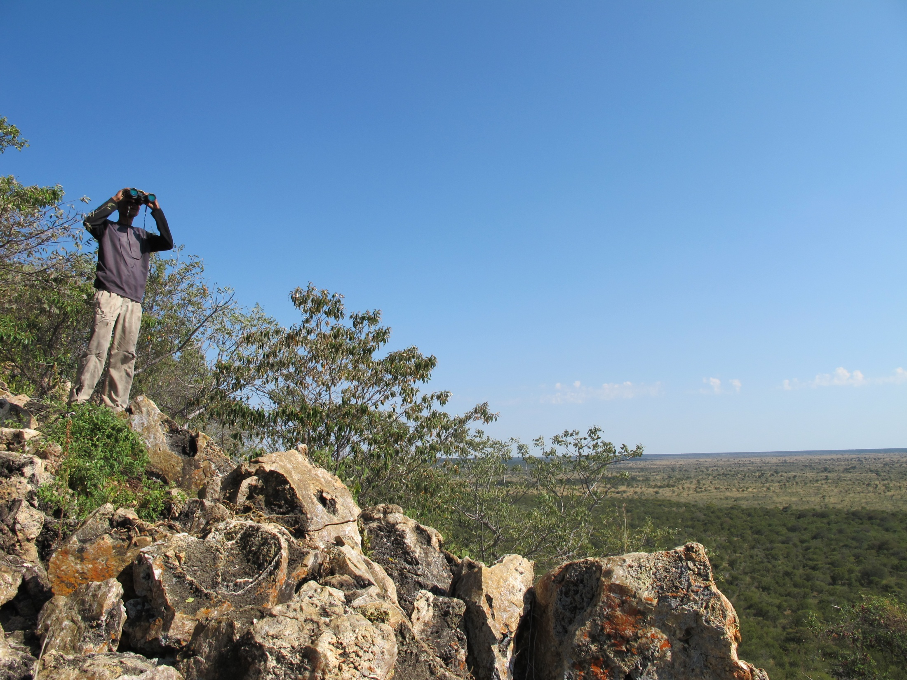
ASC – 6 March 2015:
TRAPPED IN TOURISM: BUSHMEN IN CONTEMPORARY NAMIBIA
Stasja Koot koot@iss.nl

Slide 2
Research areas

Slide 3
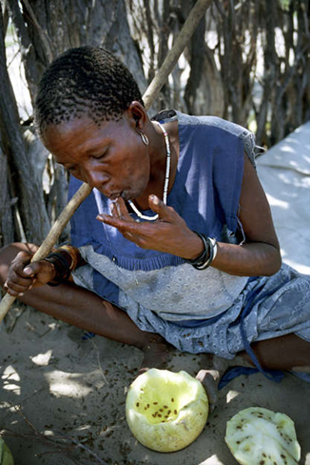
Bushmen
Early colonial days: Icons in tourism in parks
Farms workers, baasskap (Suzman, 1995; Sylvain, 2001)
After independence:
Resettlement farms, hybridity,
marginalisation
New liberal markets open up, such
as tourism

Slide 4
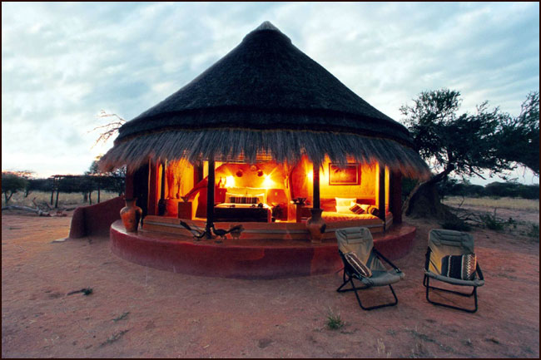
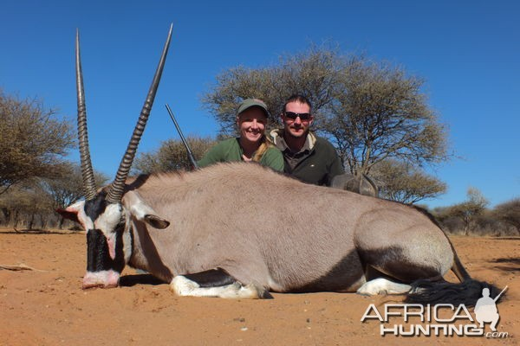
Tourism and development in Namibia
Strongly linked to nature conservation
Consumptive and non-consumptive tourism
A strong tourism bubble in Namibia, based on the South African model
A lot of development and eco-rhetoric in tourism by various stakeholders: NGOs, GRN, private sector, donors and consultants
Also by locals/hosts and tourists/guests
Trickle down effects: economic
and educational

Slide 5
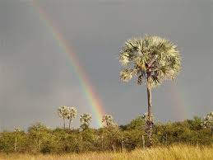
Tourism often embedded in CBNRM
CBNRM = Community-Based Natural Resource Management
Big in Southern Africa
Strong community involvement in conservation activities, a lot of tourism
Criticised: nature
first approach, eg.
Sullivan (2002)
Human-wildlife conflict
Joint ventures; a
perpetuation of baasskap?

Slide 6
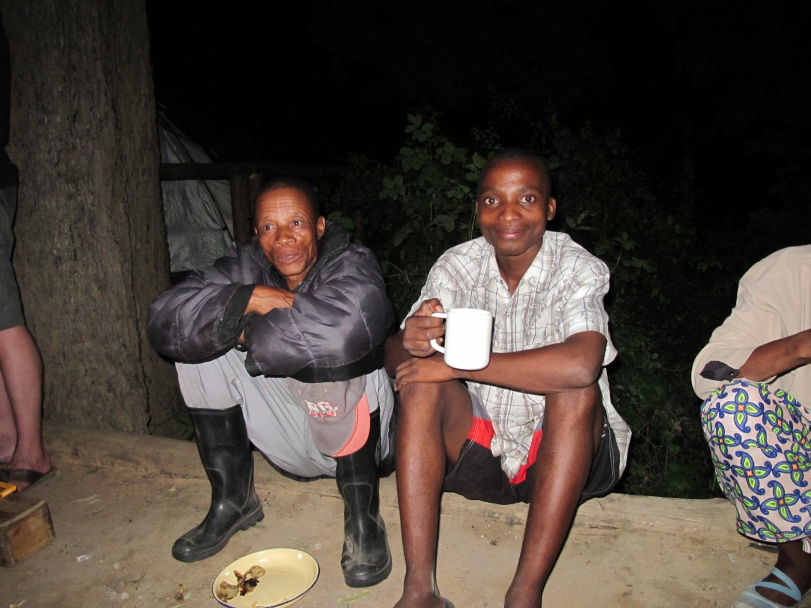
Why is Johannes afraid at N//goabaca?

Slide 7
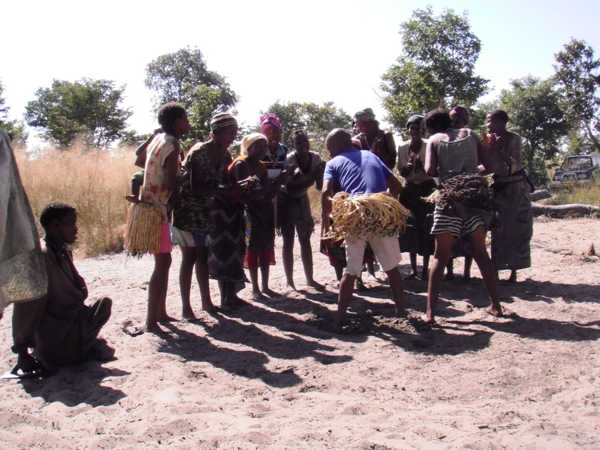
Example: Anton Dakomba and the Hiyemacan //Au
Tourism product, animal skins
What’s next? Poaching? Criminalisation?

Slide 8
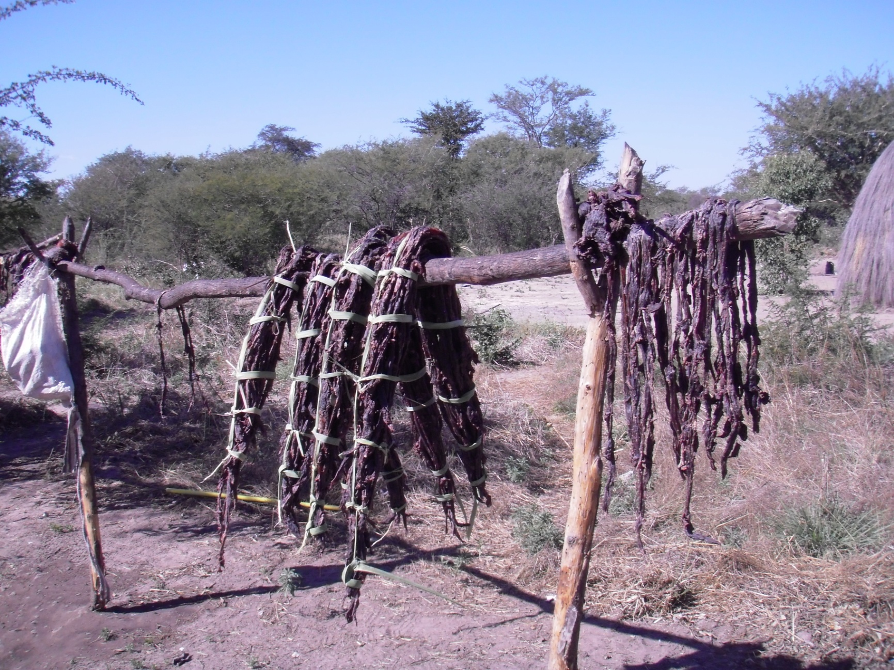
Trophy hunting
Notes:
Romantic image of hunting
Trophy hunting a white, Western phenomenon
Masculinity
Denker and Cramer, the J’/’hoansi perspectives

Slide 9
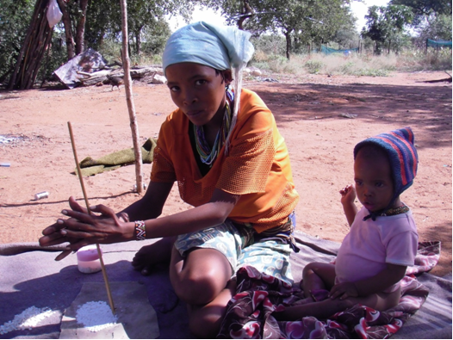
Crafts
Notes:
Gender roles
Rudolf, G!hunku

Slide 10
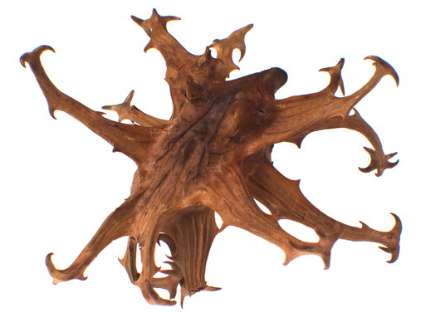
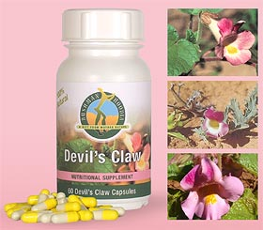
Devil’s Claw
Notes:
The global market place and CBNRM, sustainable harvesting

Slide 11
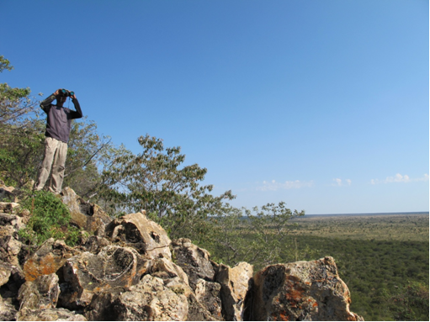
Community rangers
Notes:
Gender roles
Poaching

Slide 12
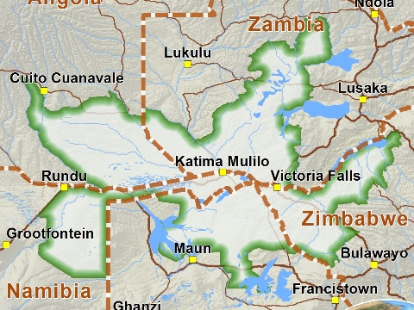
KAZA TFCA contains Nyae Nyae and Bwabwata

Slide 13
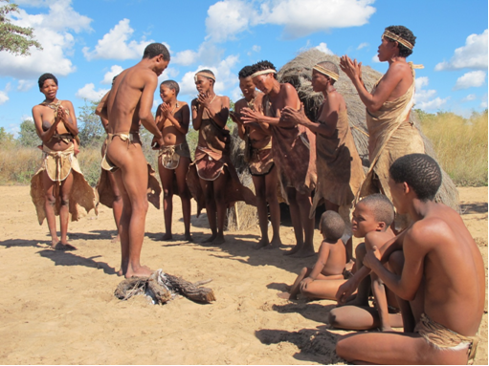
Cultural ecotourism
Notes:
John Marshall: Plastic Stone Age
The three ‘wild campsites’
Role of consultants
Changes in the social environment as well, eg. the paternalistic attitudes by expat staff (private entrepreneurialism ↔ collectivity)
The dominance of the private sector (eg. Tsumkwe Country Lodge), CBOs, consultants, NGOs, donors, government > story of the tented camps

Slide 14
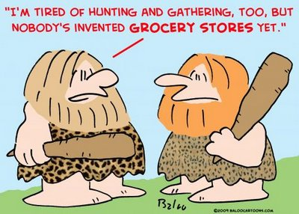
The Bushman Myth in tourism
Two Bushman images: traditional and marginalised> traditional dominant in tourism
People as part of African nature (‘fit the landscape’) (Draper, Spierenburg & Wels, 2007)
Tourism: search for authenticity/primitivity
The commoditisation of culture (Cohen, 1988)
David Fennel (2008): the myth of indigenous stewardship in ecotourism

Slide 15
The two contradictions of cultural ecotourism
Authenticity > the imposition of the inauthentic (a Western-based product) through tourism
Development > Model of economic growth dominates: Creating consumers, creating the inauthentic: Ecological stewards?

Slide 16
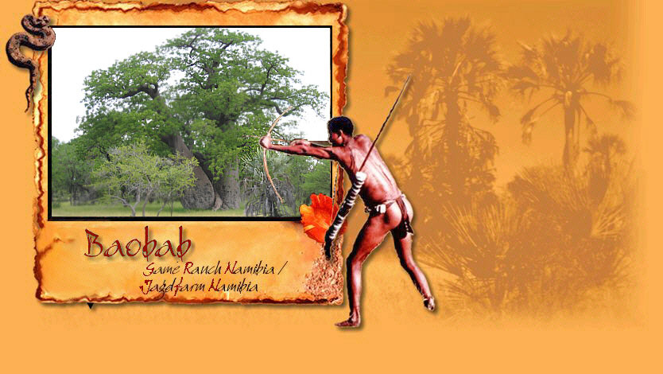
The Bushman Myth in tourism: Baobab Jagdfarm Namibia

Slide 17

The Bushman Myth in tourism: Tsumkwe Country Lodge
Cf. Van der Burg (2013) (University of Leiden, Anthropology)

Slide 18
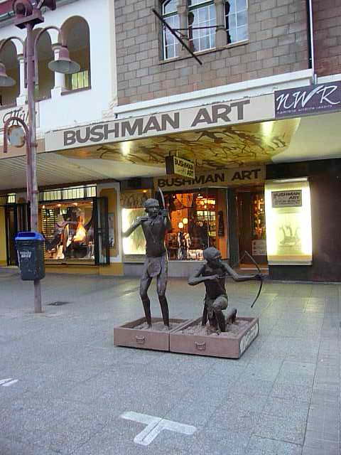
The Bushman Myth in tourism: Bushman Art and Afrikan Museum, Windhoek, Namibia
Cf. Hüncke (2010) (African Studies Centre, Leiden)

Slide 19
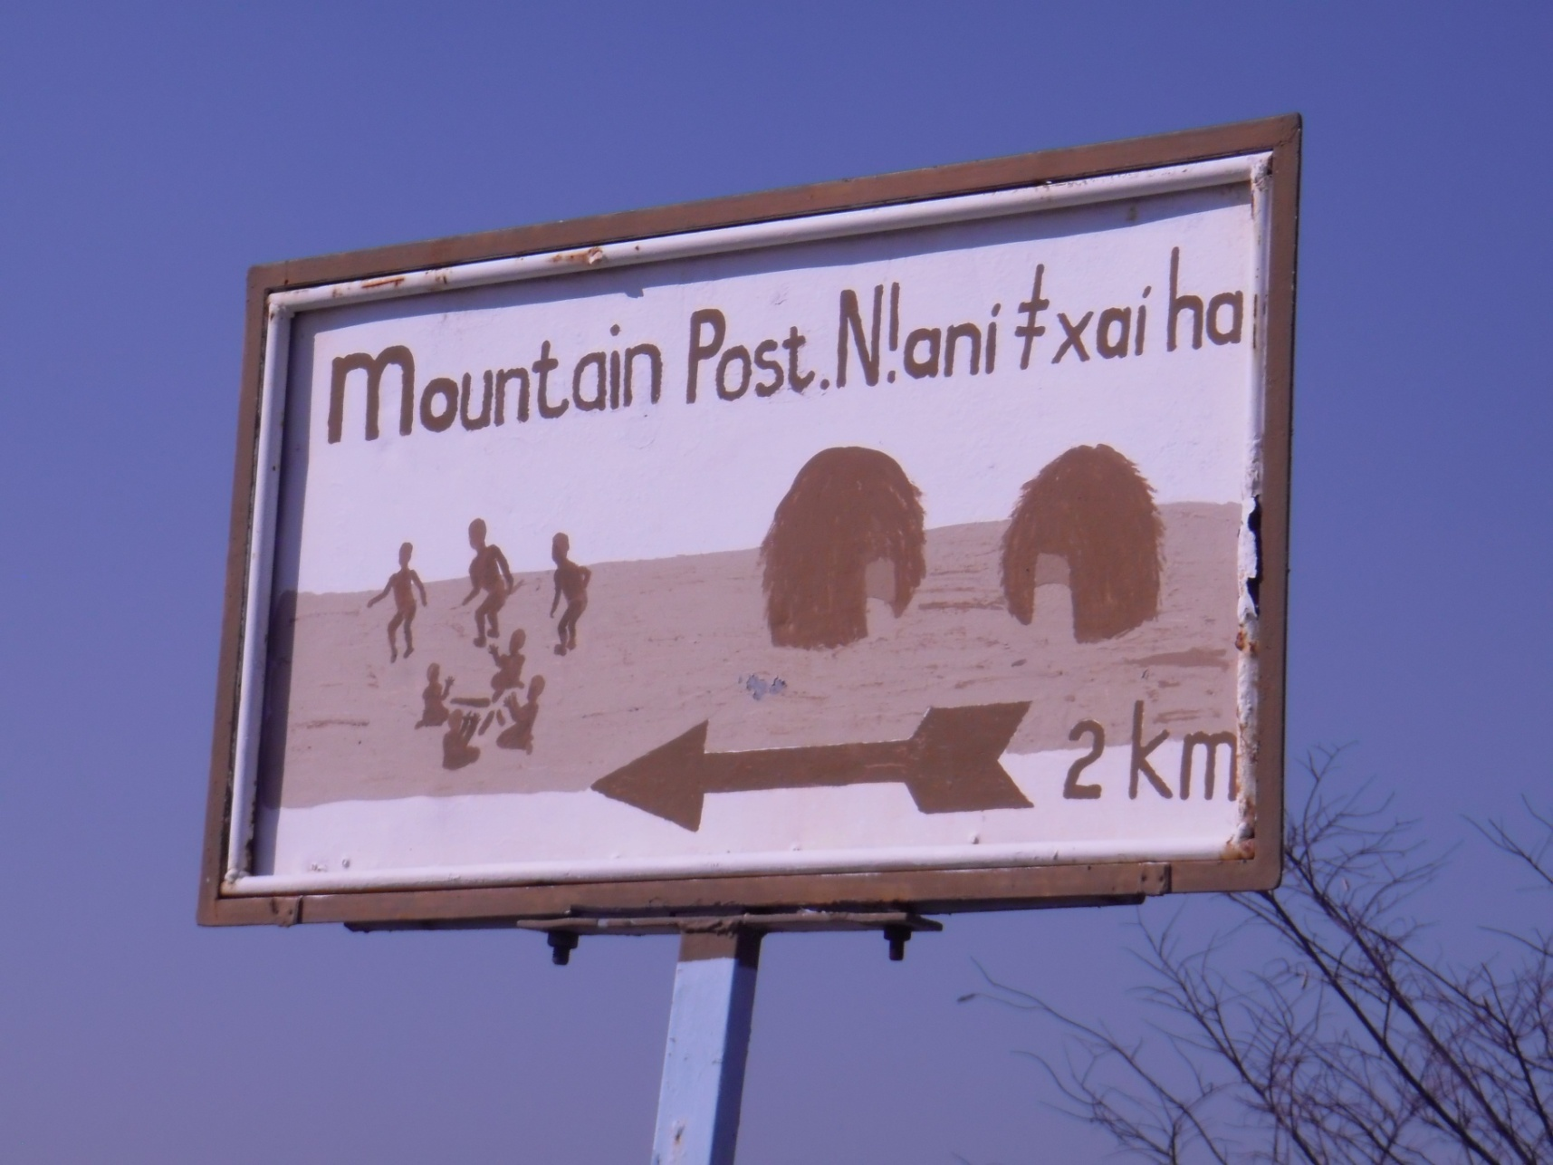
The Bushman Myth in tourism: Mountain Post, Nyae Nyae

Slide 20
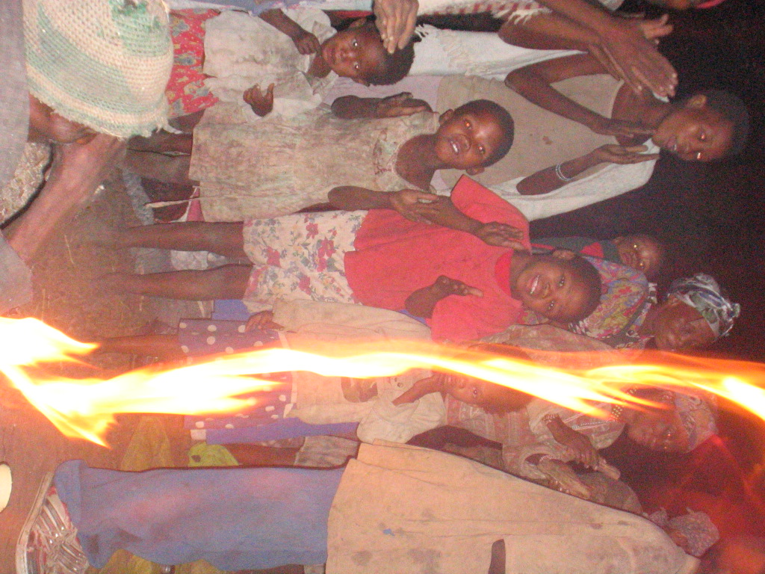
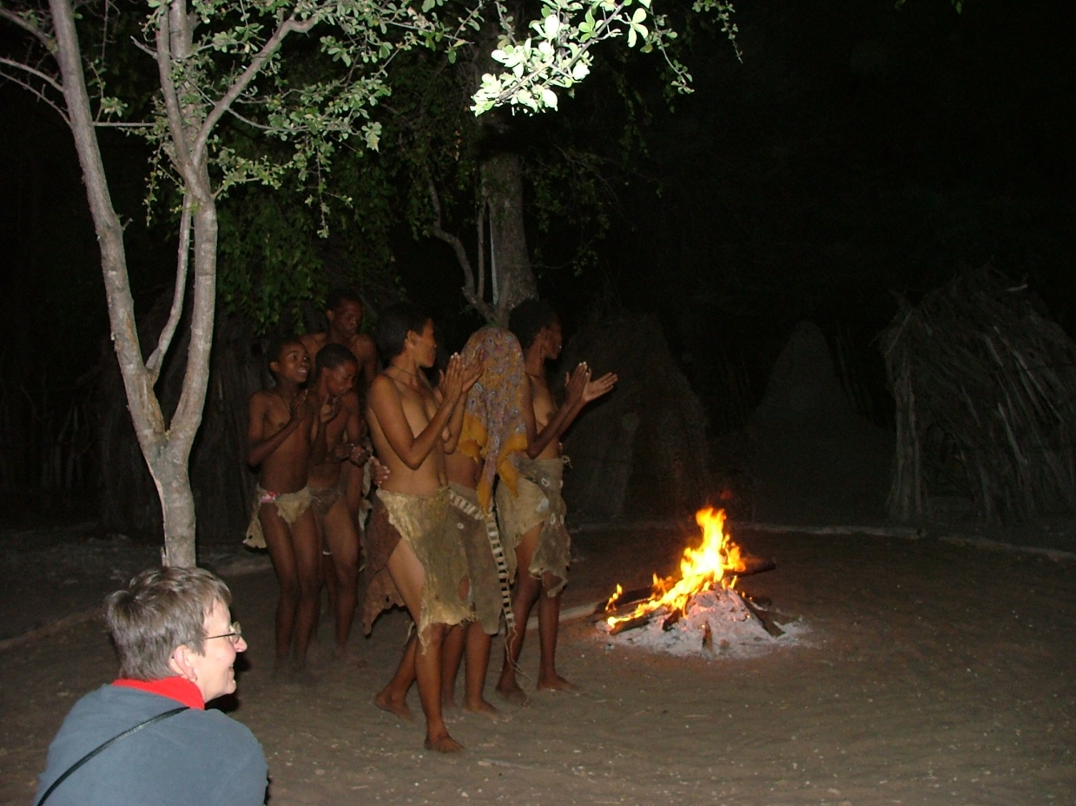
Case study: Treesleeper Camp
Village tour (back & front stage)
Bushwalk (twin brother story)
Traditional performance (back & front stage)

Slide 21
ASC – 6 March 2015:
TRAPPED IN TOURISM: BUSHMEN IN CONTEMPORARY NAMIBIA
Stasja Koot THANK YOU! koot@iss.nl

